Slide 1
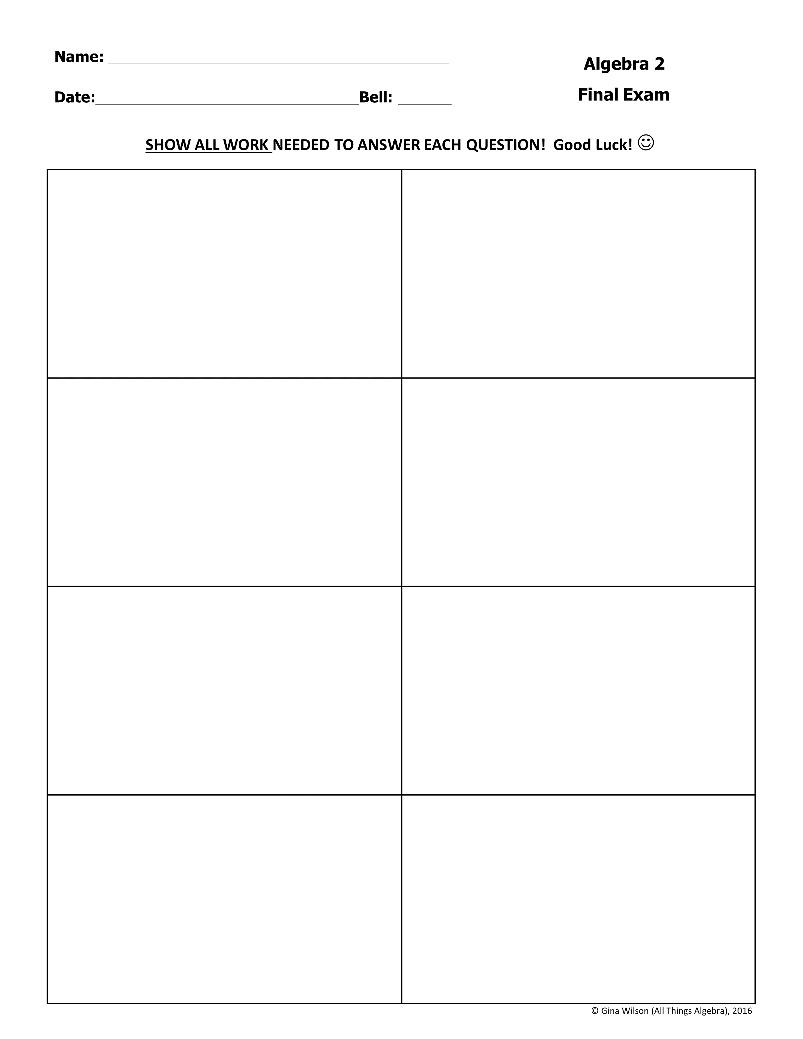
1. Which expression is equivalent to ?
2. Which expression is equivalent to ?
A. B. C. D.
A. C. B. D.
3. Which expression is equivalent to ?
4. Which expression is equivalent to ?
A. B. C. D.
A. B. C. D.
5. Which expression is equivalent to ?
6. Which expression is equivalent to ?
A. B. C. D.
A. B. C. D.
7. Which is a true statement?
8. Which is the factored form of ?
A. B. C. D.
A. B. C. D.

Slide 2


9. Assuming the denominator does not equal zero, simplify the expression below.
10. Assuming the denominator does not equal zero, simplify the expression below.
A. C. B. D.
A. C. B. D.
11. Assuming no denominator equals zero, simplify the expression below.
12. What is the solution set for the equation below?
A. C. B. D.
A. C. B. D.
13. Which inequality contains the solutions shown on the graph below?
14. What is the solution to the following equation?
A. B. C. D.
A. B. C. D.
or
or

Slide 3

15. Which equation has exactly one solution?
16. What is the solution set to the following equation?
A. B. C. D.
A. C. B. D.
17. What is the solution set to the following equation?
18. The solutions of the cubic function are and . Identify a factor of this function.
A. B. C. D.
A. B. C. D.
19. What is the solution to the following equation?
20. What is the solution to the following equation?
A. B. C. D.
A. B. C. D.

Slide 4

21. If no denominator is equal to zero, what is the solution set for the following equation?
22. If no denominator is equal to zero, what is the solution to the following equation?
A. C. B. D.
A. C. B. D.
23. Which expression is equivalent to ?
24. What is the solution to the following equation?
A. B. C. D.
A. C. B. D.
25. What is the solution to the following equation?
26. What is the solution to the following equation?
A. B. C. D.
A. C. B. D.

Slide 5

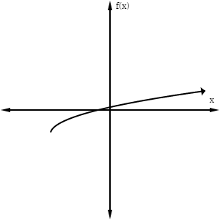
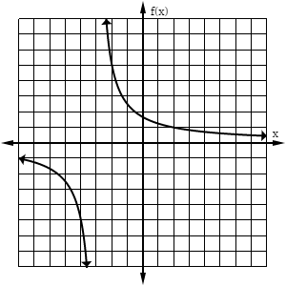
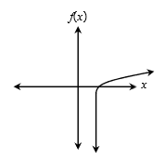
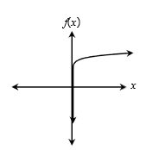
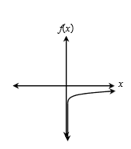
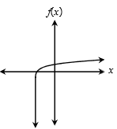
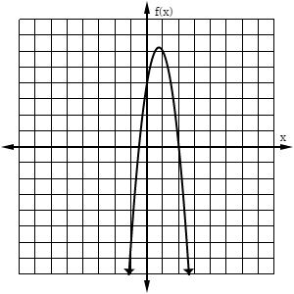
27. The graph of a function is shown below. Which family could this function belong to?
28. Which function is best represented by this graph?
A. B. C. D.
A. Exponential B. Logarithmic C. Square Root D. Cube Root
29. During which interval is the graph of the function below only increasing?
30. What is a zero of the function below?
A. C. B. D.
A. C. B. D.
31. Which graph could represent the function where ?
A.
B.
C.
D.
32. Which of the following describes the end behavior of the function as x approaches infinity?
33. Which is an apparent root of the equation graphed below?
A. B. C. D.
A. approaches 0 B. approaches -4 C. approaches D. approaches

Slide 6

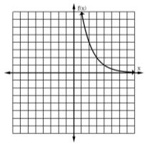
34. Which function does not have a range of the real numbers less than or equal to 0?
35. What is the equation of the horizontal asymptote of the function ?
A. B. C. D.
A. B. C. D.
36. Which function best represents this graph?
37. Which function has no restrictions in its domain?
A. B. C. D.
A. B. C. D.
38. Comparing the function to its parent function, which transformation did not take place?
39. Which function decreases through the interval and approaches as approaches ?
A. vertical translation B. horizontal translation C. vertical compression D. vertical stretch
A. B. C. D.
40. Which gives the vertical and horizontal asymptote of the following function?
41. What is the solution set for the following system of equations?
A. and B. and C. and D. and
A. B. C. D.

Slide 7

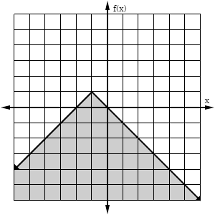
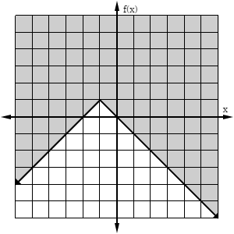
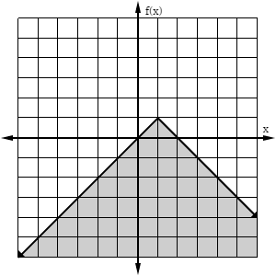
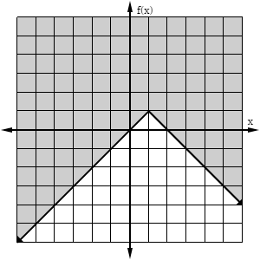
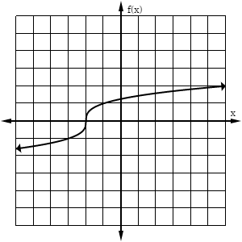
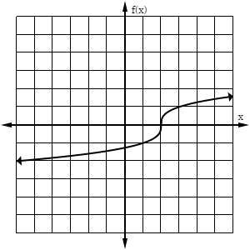
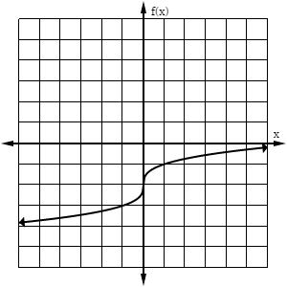
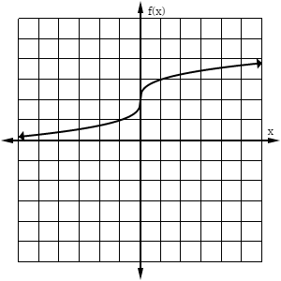
42. Which function represents the graph ?
A.
B.
C.
D.
43. Which graph shows the inverse of the function ?
A.
B.
C.
D.
44. The point (3, 4) lies on the graph of a function. The inverse of this function must contain which point?
45. If and , find .
A. (-3, -4) B. (-3, 4) C. (3, -4) D. (4, 3)
A. B. C. D.
If and , find
47. The work W done when lifting an object varies jointly with the mass m of the object and the square of the height h that the object is lifted. Which equation represents the relationship between work, mass, and volume?
A. B. C. D.
A. C. B. D.

Slide 8

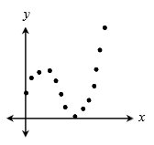
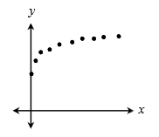
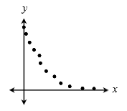
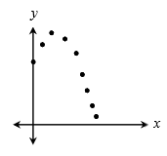
48. Given: y varies directly as x squared and inversely as z cubed. If y = 12 when x = 4 and z = 2, find x when y = 1.728 and z = 5.
49. The table below shows the population of a city during certain years since 1992. Using an exponential model, estimate the population of the city in 2016.
Year | Population
1992 | 95,242
1995 | 119,977
1998 | 151,137
2001 | 190,389
2004 | 239,935
2007 | 302,123
A. B. C. D.
A. 594,164 B. 603,934 C. 617,228 D. 625,572
50. For which set of data would the equation for the curve of best fit most likely be cubic?
A.
B.
C.
D.
51. Given , find .
52. What is the 32nd term of an arithmetic sequence with a first term of 7 and a common difference of 4?
,for
A. 41 B. 122 C. 365 D. 2,094
A. 119 B. 123 C. 127 D. 131
53. A ball is dropped from a height of 400 feet. Each time it hits the ground, it reaches a height that is three-fifths its previous height. Which formula represents the height of the ball after each bounce?
54. Given the series below, find .
A. C. B. D.
A. -2,480 B. -2,752 C. -3,016 D. -3,277

Slide 9

55. Evaluate:
56. Find the sum of the infinite series below.
A. 8,200 B. 195,312 C. -16,400 D. -292,968
A. C. B. D.
57. There are 12 girls and 10 boys in Mrs. Jones’s kindergarten class. How many ways can she choose a line leader and caboose each day?
58. A pizzeria has a choice of 15 toppings. How many ways could someone choose 3?
A. 111 B. 222 C. 231 D. 462
A. 15 B. 455 C. 2,730 D. 3,375
59. The test scores of 1,200 students are normally distributed with a mean of 83 and a standard deviation of 5.5. Under which interval did approximately 978 students score?
60. The fitness center held a weight loss competition in which 128 people participated. The amount of weight loss was normally distributed with a mean of 18 pounds and a standard deviation of 5.4 pounds. Approximately how many people lost at least 15 pounds?
A. B. C. D.
A. 72 B. 78 C. 84 D. 90

